Slide 1



KONGUNADU COLLEGE OF ENGINEERING AND TECHNOLOGY
(AUTONOMOUS)
Tholurpatti (P.O), Thottiam –T.K, Trichy – 621 215.
Department of Electronics and Communication Engineering
HX8001 - PROFESSIONAL READINESS FOR INNOVATION, EMPLOYABILITY AND ENTREPRENEURSHIP
PROJECT TITLE - CAR RESALE VALUE PREDICTION
Domain of the Project : Applied Data Science
Batch ID : B12-6A2E
Team ID : PNT2022TMID13612
Academic Year : 2022-2023
Year/Semester : IV/VII
Team Members:
VEERAMANI S (621319106099)
RAGHUL G (621319106072)
SURAJ R (621319106093)
KARTHIKEYAN M (621319106310)
Mentor:
DINESHKUMAR T

Slide 2
Table of Contents
S.No. | Content | Slide No.
1 | Objectives | 3
2 | Abstract | 4
3 | Introduction | 5
4 | Literature Survey | 6
5 | Problem Identification | 11
6 | Block Diagram | 12
7 | References | 13

Slide 3
Objectives
To Create an system for predicting the car resale value .
To ease the resale value calculation by automating it .
To get the approximate value with in no time for any car .

Slide 4
Abstract
This project is for decreasing the calculation complexity of the car resale value.
As the middle class were in rise ,the need of a car is also high, in turn lead to higher data processing .
So our model is to fasten this process ,hence decreasing
the time taken with lower error probability.

Slide 5
Introduction
Due to growth of technology, there is an sharp improvement in living standards, by automating even the simple tasks .
So the calculation of reasonable price for the reselling car is being automated.
Which is by analyzing the uploaded data about the car
with the help of data Science knowledge like ML,AI.
By proper testing and optimizing the AI , it would be of greater use to people who need to buy and also to those who want to sell their car.

Slide 6
Literature Survey
TITLE | AUTHOR & YEAR | JOURNAL NAME | REMARKS
Price Prediction of Used Cars Using Machine Learning | Chuyang Jin & 2021 | IEEE International Conference on Emergency Science and Information Technology (ICESIT) | This paper aims to build a model to predict used cars' reasonable prices based on multiple aspects, including vehicle mileage, year of manufacturing, fuel consumption, transmission, fuel type, and engine size. This model can benefit sellers, buyers, and car manufacturers in the used cars market
Prediction Of Used Car Prices Using Artificial Neural Networks And Machine Learning | C. Lakshmi & 2022 | International Conference on Computer Communication and Informatics (ICCCI) | This project presents a working model for used car price prediction with a low error value. A considerable number of distinct attributes are examined for reliable and accurate predictions. The results obtained agree with theoretical predictions and have shown improvement over models which use simple linear models. An ANN (Artificial Neural Network) is built by using Keras Regression algorithm namely Keras Regressor and namely Random Forest, Lasso, Ridge, Linear regressions are built.

Slide 7
Literature Survey
TITLE | AUTHOR & YEAR | JOURNAL NAME | REMARKS
Used Car Price Prediction using Machine Learning | Abderrahim Beni-Hssane & 2022 | 11th International Symposium on Signal, Image, Video and Communications (ISIVC) | In many business fields that are related to statistics and machine learning (ML), multiple linear regression (MLR) models are often used to estimate. In our case study, we applied several regression techniques based on supervised machine learning to predict the resale price of used cars given many factors such as mileage, fuel type, fiscal power, mark, model, and the production year of the car. In all tested models, gradient boosting regressor showed a high R-squared score and low root mean square error.

Slide 8
Literature Survey
TITLE | AUTHOR & YEAR | JOURNAL NAME | REMARKS
Prediction of Used Car Price Based on Supervised Learning Algorithm | Feng Wang & 2021 | International Conference on Networking, Communications and Information Technology (NetCIT) | In this paper, we use machine learning algorithms to predict the price of used cars with less human intervention to make the results more objective. The method used is to preprocess the dataset through Python’sPycaret package and compare the performance of each algorithm through the algorithm comparison function. Finally, the algorithm was optimized by using the hyperparameter function. The results show that R2 = 0.9807 obtained from extreme random numbers is the best performance. The algorithm was obtained and validated with new data to derive the final algorithm model.

Slide 9
Literature Survey
TITLE | AUTHOR & YEAR | JOURNAL NAME | REMARKS
Machine Learning Techniques To Predict The Price Of Used Cars: Predictive Analytics in Retail Business | Chejarla Venkat Narayana & 2021 | Second International Conference on Electronics and Sustainable Communication Systems (ICESC) | The proposed research work shows that, the predictive analytical models will be a great add-on to business mainly for assisting the decision making process. The major objective of our paper is to build a prediction model i.e., a fair price mechanism to predict the cars selling price based on their features like the car model, the number of years that a car is old, the type of fuel it uses, the type of seller, the type of transmission and the number of kilometers that the car has driven so far. This paper will help to get an approximation about selling price of a used car
Second-hand Car Price Prediction Based on a Mixed-Weighted Regression Model | Shengqiang Han & 2022 | 7th International Conference on Big Data Analytics (ICBDA) | At present, the state has not issued a standard to judge the value of second-hand car. To solve this problem, in this paper, first making feature engineering, which includes data preprocessing and feature screening. Data preprocessing includes data cleaning and data transformation, data cleaning includes removing outliers and filling missing values, and data transformation is used to unify data format to improve data quality

Slide 10
Literature Survey
TITLE | AUTHOR & YEAR | JOURNAL NAME | REMARKS
An Automated Car Price Prediction System Using Effective Machine Learning Techniques | Santosh Kumar Satapathy & 2022 | International Conference on Computational Intelligence and Sustainable Engineering Solutions (CISES) | This research focuses on Building a mathematical model that could predict the price of a second-hand car based on its current features. Determining the price of a used automobile is a difficult task because several factors like Current Mileage, Current Condition, Make, Year, etc., can influence the prediction prices of an automobile. And, from the perspective of a person who sells, it becomes a dilemma to predict the price of a second-hand car accurately.
Application of data mining technology in second-hand car price forecasting | Silin Chen & 2022 | 3rd International Conference on Electronic Communication and Artificial Intelligence (IWECAI) | Firstly, the exploration of used car data was carried out, and features with correlation up to 99%, some outliers, and missing values were found by looking at the heat map, box line plot, and violin plot. After deleting the duplicate features and outliers, three different used car datasets were obtained using three fill methods for missing values, namely, mode fill, median fill, and random forest fill.

Slide 11
Problem Identification
Used car resale market in India was marked at 24.2 billion US dollars in 2019.
Due to the huge requirement of used cars and lack of experts who can determine the correct valuation, there is an utmost need of bridging this gap between sellers and buyers.
Which can be only filled by an expert having knowledge about
every car in the market but it can be an decades old car . which may be
beyond his knowledge.
Also there is need of knowledge about mathematical formulas
And other algorithms for resale value calculation.
Also time duration for calculation is an another major issue need to be taken in to account .
Availability of the experts is an another problem, which is not easy to find one in towns and rural areas.

Slide 12
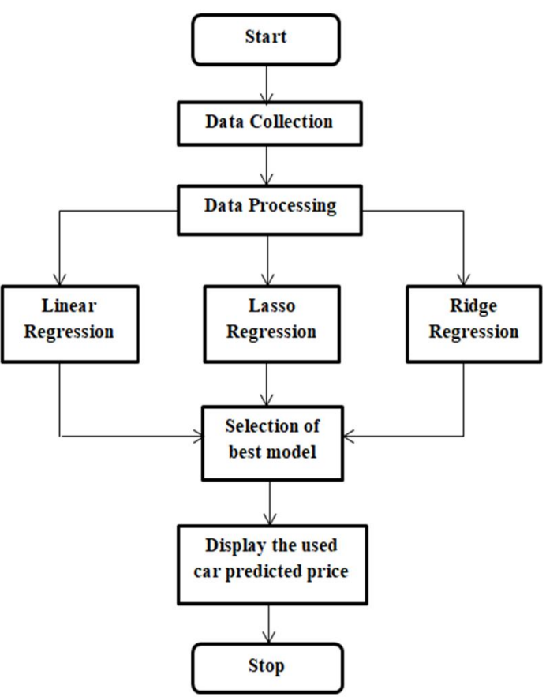
Block Diagram

Slide 13
References
[1] NATIONAL TRANSPORT AUTHORITY. 2014. Available from: http://nta.gov.mu/English/Statistics/Pages/Archive.aspx [Accessed 15 January 2014].
[2] MOTORS MEGA. 2014. Available from:
http://motors.mega.mu/news/2013/12/17/auto-market-8-decrease-sales-newcars/ [Accessed 17 January 2014].
[3] LISTIANI, M., 2009. Support Vector Regression Analysis for Price Prediction in a Car Leasing Application. Thesis (MSc). Hamburg University of Technology.
[4] RICHARDSON, M., 2009. Determinants of Used Car Resale Value. Thesis (BSc). The Colorado College.
[5] WU, J. D., HSU, C. C. AND CHEN, H. C., 2009. An expert system of price forecasting for used cars using adaptive neuro-fuzzy inference. Expert Systems with Applications. Vol. 36, Issue 4, pp. 7809-7817.
[6] DU, J., XIE, L. AND SCHROEDER S., 2009. Practice Prize Paper - PIN Optimal Distribution of Auction Vehicles System: Applying Price Forecasting, Elasticity Estimation and Genetic Algorithms to Used-Vehicle Distribution. Marketing Science, Vol. 28, Issue 4, pp. 637-644.

Slide 14
References
[7] WEKA 4: DATA MINING SOFTWARE IN JAVA. 2014. Available from:
http://www.cs.waikato.ac.nz/ml/weka/index.html [Accessed 17 January 2014].
[8] LI, Y. H. AND JAIN, A. K., 1998. Classification of Text Documents. The
Computer Journal, Vol. 41, pp. 537-546.
[9] QUINLAN, J. R., 1993. C4.5: Programs for Machine Learning. Morgan
Kaufmann.
[10] MITCHELL, T. M., 1997. Machine Learning. McGraw-Hill, Inc. New York,
NY, USA.

Slide 15
Questions & Discussion

Slide 16
THANK YOU

